Slide 1
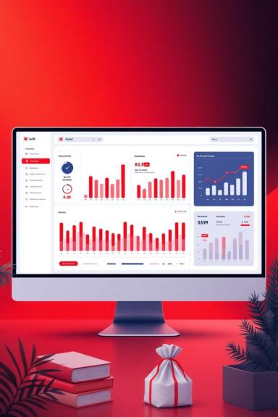
UK Retail Sales Analysis
Customer & Product Intelligence from 1M+ Transactions

Slide 2
Project Objectives
Customer Segmentation
Lifetime Value
Cohort Analysis
RFM Analysis to identify behavior patterns
Calculate and optimize Customer LTV
Track retention and purchase behavior
Product Performance
Price Sensitivity
Identify top performers and declining SKUs
Understand segment-level preferences

Slide 3
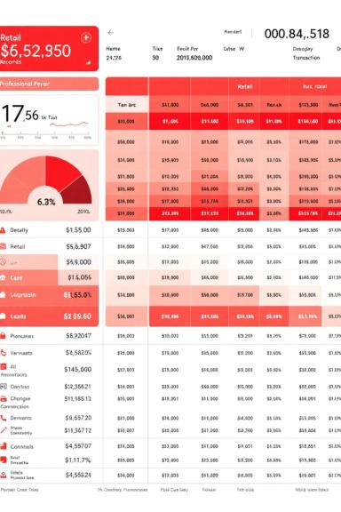
Dataset Overview
Source & Scale
1M+
Online Retail Dataset from Kaggle
1,068,498 transactions analyzed
Transactions
2 Excel files combined
UK-based e-commerce store
2
Key Fields
Invoice, StockCode, Description, Quantity, InvoiceDate, Price, Customer ID, Country
Files Combined

Slide 4

Customer Insights
Top Customers
At-Risk Segments
Highest LTV driven by consistent, high-value purchases
Recent & Low-Spending customers show low retention
Action Required
Implement retention strategies and upsell campaigns

Slide 5
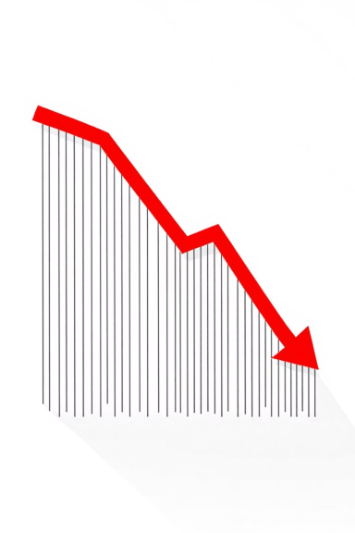

Retention drops after 2 months
Critical insight from cohort analysis
Strategic Priority: Improve post-purchase engagement to extend customer lifecycle

Slide 6




Product Performance Discoveries
Volume vs Revenue
Segment Preferences
Declining Trends
Most sold product ≠ Top revenue product
Distinct product preferences by customer segment
Identified slow-moving SKUs for review

Slide 7

Price Sensitivity Analysis
Optimal Price Range
£2–£10 is most preferred by customers
Strategic Actions
Reevaluate slow-moving SKUs
Tailor pricing strategy by segment
Optimize product mix in sweet spot

Slide 8

Analytical Toolkit
Python & Pandas
Seaborn & Matplotlib
Jupyter Notebook
Data manipulation and analysis
Advanced visualization libraries
Interactive exploration and documentation
All code, visuals, and insights fully embedded in notebook

Slide 9

Visual Insights Delivered
Trend Analysis
Heatmaps
Line charts for sales and revenue trends
Retention, product preference, price sensitivity
Segment Comparison
LTV and AOV by customer segment

Slide 10

Project Impact
Demonstrates practical skills in data cleaning, customer segmentation, product analytics, and insight-driven storytelling
Ideal For
Data analyst roles in e-commerce and retail domains
Contact
Mohammad Zaid Ansari
LinkedIn | GitHub

